Slide 1
Spatial Centrality: an approach with sectoral linkages
Nuno Crespo, M. Paula Fontoura and Nádia Simões

Slide 2
Purpose
To build a measure to evaluate the degree of centrality (advantage) of a sector located in a region considering
-internal and external components;
-economic and geographic aspects.
The hypothesis is that the spatial centrality of a sector varies:
- positively with geographic proximity to firms in the same economic sector (horizontal agglomeration) and in other sectors connected by vertical linkages (vertical agglomeration)
-negatively with inter-regional distance.

Slide 3
Centralidade Económica e Geográfica
Aumento de 10% na distância
Diminuição de 9% no comércio bilateral
Relevância da Distância
Importância da proximidade aos mercados

Slide 4
Channels through which a firm may benefit from linkages with firms closely located
Intra-industry agglomeration: demonstration/imitation, labor mobility and competition.
Inter-industry agglomeration:Vertical relationships that firms establish with suppliers (backward linkages) or customers of intermediate inputs produced by them (forward linkages).
The two effects will be considered both in the region of location of the sector under analysis and in the other regions related to it.

Slide 5
The novelty of our index
The definition of “economic size” takes into consideration both intra and inter-sectoral effects.
We use a sectoral approach

Slide 6
An index with a double reading
It allows to identify:
The sectors in which the region has a higher/lower degree of centrality
The regions with a greater degree of centrality in this sector.
To illustrate the method, we include an example for the Portuguese economy at the county level (275 regional units).

Slide 7
The “family” of our index
The indicators available in the literature to encapsulate the real spatial economy fall into two broad types:
a group that measures the degree of concentration (agglomeration) of economic activity in a location unit;
a group comprising accessibility and peripherality (identical to low accessibility) indices, aiming to describe a particular location taking into account “opportunities, activities or assets in other areas and the area itself” (Wegener et al., 2002).

Slide 8
Why measuring accessibility?
The concept of accessibility explicitly incorporates and quantifies the external influence.
A picture of the factors that constitute an obstacle to an easier access to the markets is valuable knowledge for policy actors.

Slide 9
Acessibilidade aos Mercados
Serve para analisar a localização ótima:
Localização
Entre países
Entre regiões
Entre localizações numa cidade
Etc.
No fundo, responder a: “qual a região que assegura melhor acesso às outras?”

Slide 10
The “paternity” of our index
It is based on a gravity model to estimate “economic” or “market” potential.
In its traditional formulation, the potential for economic activity of a location is a function both of its proximity to other economic centers and of their economic size or "mass“ (Keeble et al, 1982,1988). Potential is thus interpreted as a measure of interactions with the regions making up the system.
Later, Frost and Spence (1995) added the role of self-potential, i.e. the effect of size and the level of economic activity of a location on its own peripherality index.

Slide 11

Keeble, Owens, Thompson (1982) e Keeble, Offord, Walker (1988)
$$P_{i}=\sum_{h}{\frac{M_{h}}{δ_{ih}}}$$
$$C_{i}=\frac{l_{i}}{δ_{ii}}+\sum_{h}{\frac{l_{h}}{δ_{ih}}}, i≠h$$

Slide 12
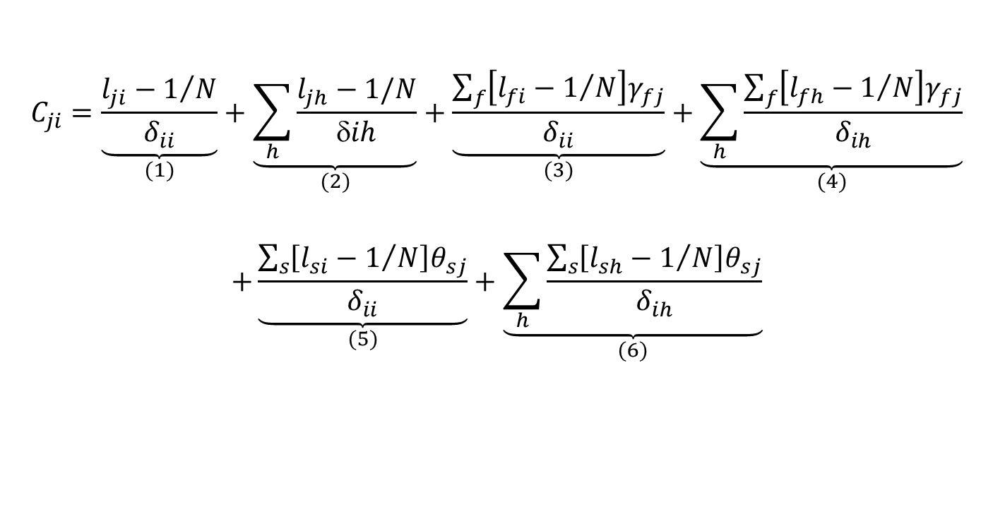
The index
$$C_{ji}=\underset{(1)}{\underbrace{\frac{l_{ji}−1/N}{δ_{ii}}}}+\underset{(2)}{\underbrace{\sum_{h}{\frac{l_{jh}−1/N}{δih}}}}+\underset{(3)}{\underbrace{\frac{\sum_{f}{\left[l_{fi}−1/N\right]γ_{fj}}}{δ_{ii}}}}+\underset{(4)}{\underbrace{\sum_{h}{\frac{\sum_{f}{\left[l_{fh}−1/N\right]γ_{fj}}}{δ_{ih}}}}}$$
$$+\underset{(5)}{\underbrace{\frac{\sum_{s}{\left[l_{si}−1/N\right]θ_{sj}}}{δ_{ii}}}}+\underset{(6)}{\underbrace{\sum_{h}{\frac{\sum_{s}{\left[l_{sh}−1/N\right]θ_{sj}}}{δ_{ih}}}}}$$

Slide 13
First term: horizontal internal component
It measures the degree of over-representation of sector j in the region i (i.e., compared with the even distribution by all regions of that economic activity).
Usually the potential model quantifies the variable “mass” with the absolute value of the variable used for the evaluation of the economic dimension of the regions. We prefer to consider instead the proportion of that variable.
We divide by intra-regional distance in order to incorporate the geographic dimension of the region and the fact that the economic over-representation of the sector varies negatively with the dimension of ​​the region.
- The higher the ratio , the greater the effect of intra-sectoral agglomeration-.

Slide 14
Second term: horizontal external component
It measures the degree of over-representation of a sector in the remaining regions (forming part of the system of regional relations under analysis), assuming that the importance of this effect varies inversely with the distance between the regions.

Slide 15
Third term: backward internal component (proximity to suppliers)
It measures the degree (per spatial unit) of over-representation of suppliers of the sector in the region (backward linkages) weighted by the importance of these suppliers to the sector.

Slide 16
Fourth term: backward external component (proximity to suppliers)
It comes to a similar analysis of the third but in the remaining regions.
The geographic effect is the “distance decay”, as in the second term.

Slide 17
Fifth term: forward internal component (proximity to buyers)
It measures (per spatial unit) the degree of over-representation of buyers of the sector in the region (forward linkages) weighted by the importance of these buyers to the sector.

Slide 18
Sixth term: forward external component ( proximity to buyers)
This term comes to a similar analysis of the fifth term but in the remaining regions.
The geographic effect is the “distance decay”, as in the second term.

Slide 19
Empirical example
Statistical information for the Portuguese economy (excluding Madeira and Azores) in 2006
Level of the county (concelho). Portugal is divided into 275 counties (with an average area of 323.79Km²).
As for sectors, we considered the manufacturing industry sectors at 2 digit level (23 sectors)
The dimension of a sector in each region is evaluated by the proportion of that sector located in each county, measured in terms of employment.
We consider inter and intra-regional distances between all counties – 75350 bilateral distances and 275 internal distances .
-Inter-regional distances – are obtained in kilometers (km).
- Intra-regional distances are linked to the area of the region, by considering the formula of Keeble et al. (1982, 1988) and Brülhart (2001).
Employment data is from Ministry of Employment while distances are obtained from the program ROUTE 66.
There was the purpose of comparing these data with a later year. That turned out not to be done because in the meanwhile the NACE nomenclature used in this study (revision 2) has been modified and it is not possible to convert one into the other.

Slide 20
Presentation of results
Given the vast number of counties analyzed, we selected those corresponding to the capital of the district (Continental Portugal is also divided into 18 districts).
For reason of parsimony, we show the index for two sectors (disaggregating by county) and for one county (disaggregating by sector).
The sectors: those with the highest values in terms of the total level of centrality (i.e., the sum of the several components of the centrality index) –, namely wearing apparel, dressing and dyeing of fur (sector 18) and machinery and equipment n.e.c. (sector 29)
The county: the one with the highest (total) level of centrality-Porto

Slide 21
Centrality by components in Porto
Selecting the two sectors with the highest levels of centrality in Porto – office machinery and computers (30), and radio, television and communication equipment (32) –, in both cases the major component has to do with the characteristics of the region where the sector is located -respectively the economic size of the region (1) and proximity to buyers (5).
This result is consistent with the fact that Porto is the second most prosperous region of the country.

Slide 22
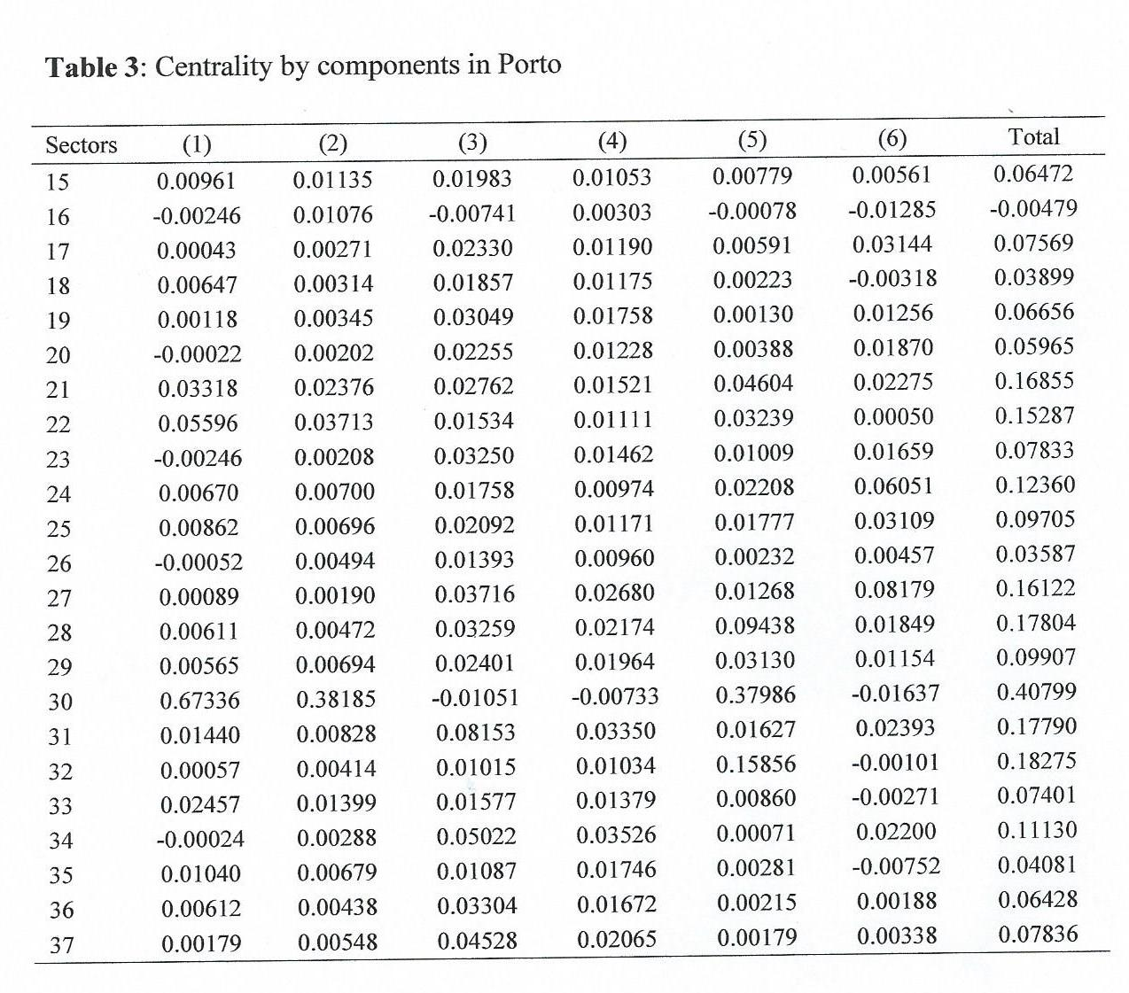

Slide 23
Centrality by components in sector 18 (wearing apparel, dressing and dyeing of fur)
The county with the highest centrality level for this sector is Braga .
Only three counties (Viana do Castelo and Porto in addition to Braga), all located close to each other, reveal good conditions in terms of centrality in this sector, as the sum of the several components is negative for the remaining counties.
Focusing on the contribution of each term of the centrality index with positive sign in Braga, by decreasing order stands out the proximity to suppliers in the region in which the sector is located (3) and in the nearby regions (4), followed by the economic dimension of the nearby regions (2) and of the region in which the sector is located (1); proximity to customers in the county (5) comes at the end of the ranking.
Curiously enough, the qualitative results are very similar for the two other counties (Porto and Viana do Castelo), confirming the importance of proximity to suppliers and to similar activity as relevant factors of location in the case of this sector.

Slide 24
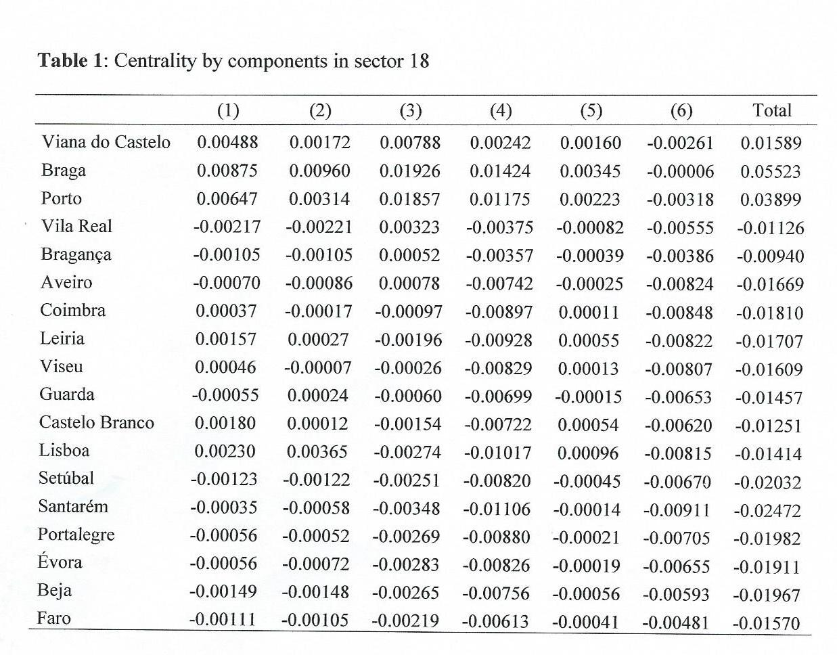

Slide 25
Centrality by components in sector 29 (machinery and equipment n.e.c)
Considering the county with the highest level of centrality in this sector (Porto), the results highlight, by decreasing order, the internal proximity to buyers (5), the internal proximity to suppliers (3), the external proximity to suppliers (4) and buyers (6), and lastly, the external and internal economic components (2 and 1, respectively).
Thus, the most important factors have all an inter-sectoral type, both backward and forward. These results are in accordance with the inherent characteristics of these sectors.
Turning now to the 2nd county in terms of the total value of the index, Lisboa, we observe that now stand out, in descending order, the economic dimension of the nearby regions (2) and of the region itself (1), followed by internal proximity to buyers (5), which is in line with the particular attractiveness conditions of a region that hosts the nation's capital.

Slide 26
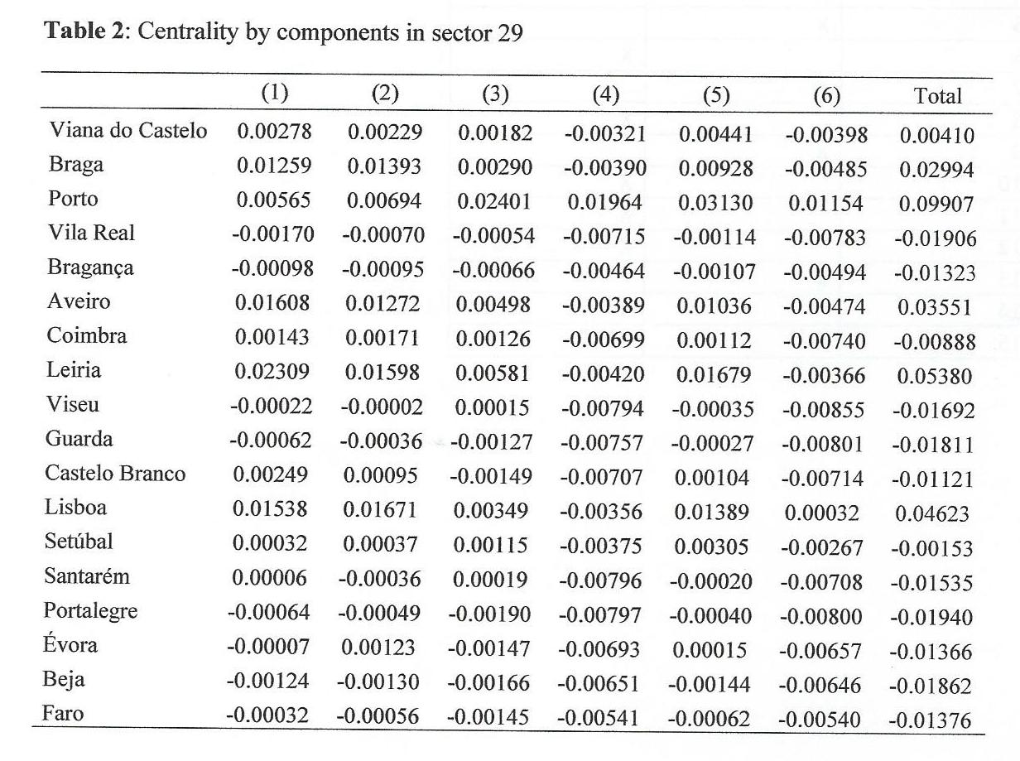

Slide 27
Centrality by components in specific sectors-global evaluation
In the privileged region for location of each sector, results are in accordance with the inherent characteristics of these sectors.
Of course different results can be observed for the same sector on different regions since the sectoral level chosen for this analysis is very aggregated; it is possible that within the same sector there are products more sensitive than others to a specific type of location factors.

Slide 28
The way forward to improve the index
Even the most sophisticated centrality indicators are at best surrogates for a vaguely perceived notion of “mass” of a region and “distance costs”. For instance, to the centrality level of a sector also contributes the absorptive capacity of the region where the sector locates, given for instance by support infrastructures. It may be that the way forward for this type of indicators lies in some more direct measurement of these effects .
The additive formulation of our index may also be scrutinized.

Slide 29
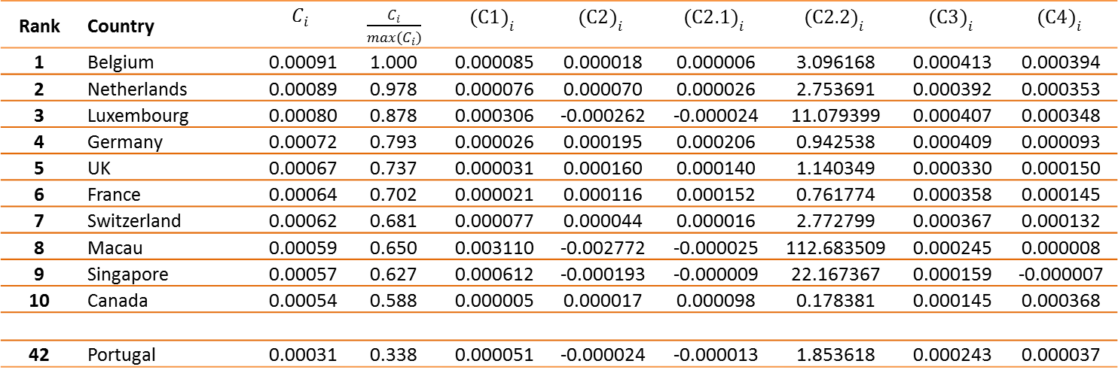
Centralidade económica e geográfica por países
Table 1: The centrality index and its four components – 1st method
Rank | Country | $$C_{i}$$ | $\frac{C_{i}}{max(C_{i})}$ | $${(C1)}_{i}$$ | $${(C2)}_{i}$$ | $${(C2.1)}_{i}$$ | $${(C2.2)}_{i}$$ | $${(C3)}_{i}$$ | $${(C4)}_{i}$$
1 | Belgium | 0.00091 | 1.000 | 0.000085 | 0.000018 | 0.000006 | 3.096168 | 0.000413 | 0.000394
2 | Netherlands | 0.00089 | 0.978 | 0.000076 | 0.000070 | 0.000026 | 2.753691 | 0.000392 | 0.000353
3 | Luxembourg | 0.00080 | 0.878 | 0.000306 | -0.000262 | -0.000024 | 11.079399 | 0.000407 | 0.000348
4 | Germany | 0.00072 | 0.793 | 0.000026 | 0.000195 | 0.000206 | 0.942538 | 0.000409 | 0.000093
5 | UK | 0.00067 | 0.737 | 0.000031 | 0.000160 | 0.000140 | 1.140349 | 0.000330 | 0.000150
6 | France | 0.00064 | 0.702 | 0.000021 | 0.000116 | 0.000152 | 0.761774 | 0.000358 | 0.000145
7 | Switzerland | 0.00062 | 0.681 | 0.000077 | 0.000044 | 0.000016 | 2.772799 | 0.000367 | 0.000132
8 | Macau | 0.00059 | 0.650 | 0.003110 | -0.002772 | -0.000025 | 112.683509 | 0.000245 | 0.000008
9 | Singapore | 0.00057 | 0.627 | 0.000612 | -0.000193 | -0.000009 | 22.167367 | 0.000159 | -0.000007
10 | Canada | 0.00054 | 0.588 | 0.000005 | 0.000017 | 0.000098 | 0.178381 | 0.000145 | 0.000368
42 | Portugal | 0.00031 | 0.338 | 0.000051 | -0.000024 | -0.000013 | 1.853618 | 0.000243 | 0.000037

Slide 30
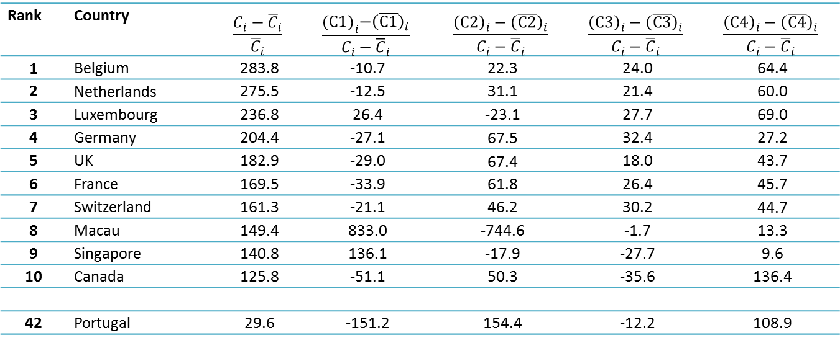
Centralidade Económica e Geográfica por países
Table 3: Contribution of the four components to the centrality index – 1st method
Rank | Country | $$\frac{C_{i}−{\overline{C}}_{i}}{{\overline{C}}_{i}}$$ | $$\frac{{(C1)}_{i}−{\left(\overline{C1}\right)}_{i}}{C_{i}−{\overline{C}}_{i}}$$ | $$\frac{{\left(C2\right)}_{i}−{\left(\overline{C2}\right)}_{i}}{C_{i}−{\overline{C}}_{i}}$$ | $$\frac{{\left(C3\right)}_{i}−{\left(\overline{C3}\right)}_{i}}{C_{i}−{\overline{C}}_{i}}$$ | $$\frac{{\left(C4\right)}_{i}−{\left(\overline{C4}\right)}_{i}}{C_{i}−{\overline{C}}_{i}}$$
1 | Belgium | 283.8 | -10.7 | 22.3 | 24.0 | 64.4
2 | Netherlands | 275.5 | -12.5 | 31.1 | 21.4 | 60.0
3 | Luxembourg | 236.8 | 26.4 | -23.1 | 27.7 | 69.0
4 | Germany | 204.4 | -27.1 | 67.5 | 32.4 | 27.2
5 | UK | 182.9 | -29.0 | 67.4 | 18.0 | 43.7
6 | France | 169.5 | -33.9 | 61.8 | 26.4 | 45.7
7 | Switzerland | 161.3 | -21.1 | 46.2 | 30.2 | 44.7
8 | Macau | 149.4 | 833.0 | -744.6 | -1.7 | 13.3
9 | Singapore | 140.8 | 136.1 | -17.9 | -27.7 | 9.6
10 | Canada | 125.8 | -51.1 | 50.3 | -35.6 | 136.4
42 | Portugal | 29.6 | -151.2 | 154.4 | -12.2 | 108.9

